Slide 1



Capstone Project:
Sales Management System for Major Education
GSP21SE12
Mr. Lai duc hung (Instructor)

Slide 2
Team members
Pham Thi Ngoc Ha (SE130460) Team Leader
Nguyen Hoang Gia (SE63203) Team Member
Le Gia Nguyen (SE63042) Team Member

Slide 3
Outline
01
03
Introduction
Outcome
p.04
p.34
02
04
Our Approach &
Limitations &
Demonstrations
Future plans
p.08
p.35

Slide 4
01
Introduction

Slide 5
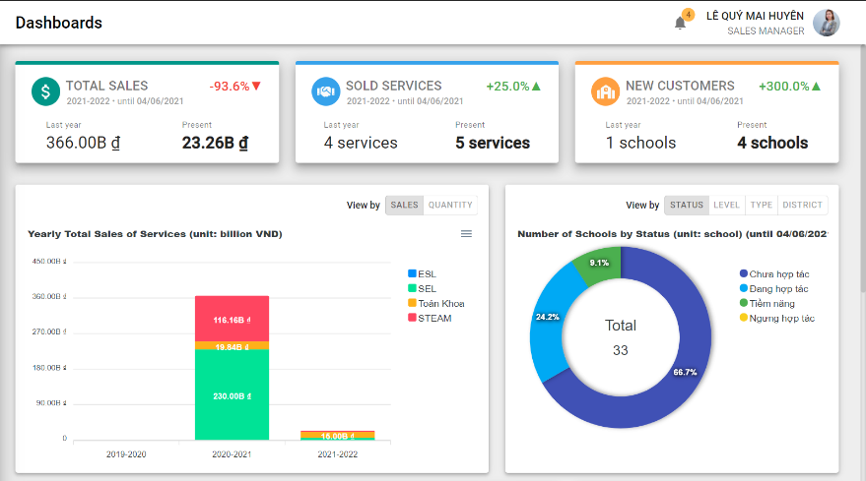
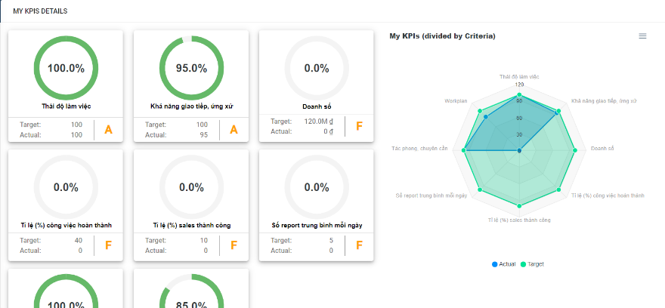

01 Introduction
Web Application
Set up & assign tasks quickly
Track & monitor progress accurately and timely
Optimize employee performance
Work any time, at any where
Notes:
Thiết lập & phân công công việc nhanh chóng
Theo dõi & giám sát tiến độ chính xác, kịp thời
Báo cáo & tối ưu hiệu suất làm việc của nhân viên
Linh hoạt, làm việc mọi lúc mọi nơi, miễn là có Internet

Slide 6


01 Introduction
Roles:
Sales Manager /
Sales Supervisor
Salesman

Slide 7
01 Introduction
Improvements:
Definition of “TASK”
Suggestion for Sales Manager when assign tasks
Definition of “KPI”

Slide 8
02
Our
Approach

Slide 9








02 Our Approach
Context:
Make a plan, choose target customers
for Sales period
Assign tasks for Salesmen
& monitor progress
Evaluate Salesman performance
Statistic Sales/Revenue & customers
Mr. Tien
Sales Manager
…
All handling manually by

Slide 10



02 Our Approach
Make a plan, choose target
customers for Sales period efficiently
Context:
Assign tasks for Salesmen reasonably
& monitor progress easily
Evaluate Salesman performance
automatically
Statisticize sales figures & customer
segments visually
Mr. Tien
Save time, minimize errors & handle arising timely
Sales Manager
Satisfy business policies and processes
Notes:
Thoả mãn chính sách và các quy trình hiện tại của doanh nghiệp

Slide 11

02 Our Approach
Context:
Sales Management System for
Mr. Tien
Sales Manager
Notes:
Thoả mãn chính sách và các quy trình hiện tại của doanh nghiệp

Slide 12
Feature 1
Definition of Tasks

Slide 13







02 Our Approach
Definition of “TASK”
[
Chăm sóc
Tái ký hợp đồng
Đang hợp tác
Ký mới hợp đồng
Task
Sales mới
Chưa hợp tác
Notes:
Đầu tiên là làm rõ về loại tasks
Đặc thù phòng ban của anh Tiến

Slide 14
02 Our Approach
Definition of “TASK”
Flow of state changing:
3a. Approve services (M) /
Mark as complete (S)
Successful
Deadline
1. Create (M)
2. Assign (M)
Not started
Ongoing
Failed
Failed
Start date
Note:
M Sales Manager
S Salesman
3b. Mark as failed (S)

Slide 15

02 Our Approach
Definition of “TASK”
Task results: “Failed”
Chăm sóc
Tái ký hợp đồng
(1) Salesman confirms failed
Failed
(2) Overdue deadline
Ký mới hợp đồng
Task
(*)
Sales mới
Chưa hợp tác
Tiềm năng
(*) Special case

Slide 16


02 Our Approach
Definition of “TASK”
Task results: “Successful”
Chăm sóc
Salesman confirms completed
before deadline
Successful
Tái ký hợp đồng
Service(s) submitted
&& approved
Ký mới hợp đồng
Task
(*)
Sales mới
Chưa hợp tác
Đang hợp tác
(*) Special case

Slide 17

Demo
Tasks management

Slide 18
Feature 2
salesman Suggestion when assign tasks

Slide 19




02 Our Approach
Suggestion when assign tasks
Assign PIC fast and efficiently
Divide tasks fairly to salesmen
Utilize the maximum uses of
resources and opportunities
Mr. Tien
Sales Manager
Notes:
- Nhanh chóng, hiệu quả?
Phân chia công việc công bằng, đồng đều cho mọi Salesman
Tận dụng tối đa nguồn lực và cơ hội, có thể kể đến như các mối quan hệ có sẵn của Salesman với 1 trường nào đó, hay là Salesman này gần trường nào đó để thuận tiện đi lại hơn

Slide 20
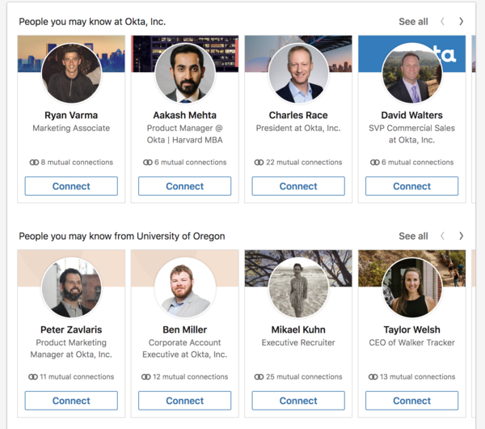
02 Our Approach
Suggestion when assign tasks
How is suggestions?
Case 1:
Social network
location
Relationship network

Slide 21
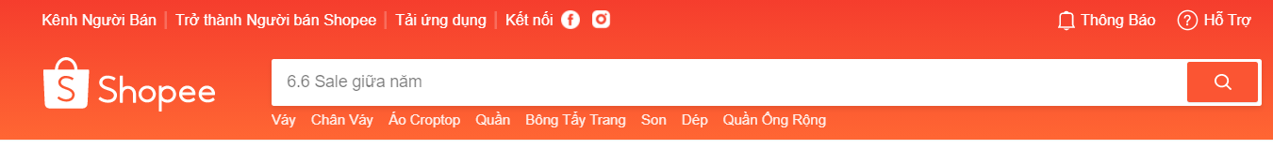
02 Our Approach
Suggestion when assign tasks
How is suggestions?
Case 2:
E-commerce
Personal purchase data
Customer interests / trend
Compare to sample data

Slide 22

02 Our Approach
Suggestion when assign tasks
How to suggestions?
Define purpose and benefits
Select suitable criteria
Choose the appropriate suggestion method

Slide 23


02 Our Approach
Suggestion when assign tasks
How to suggestions? – Step 1
Our purposes:
More objective, increase automation
Enabling Salesmen to work more effectively, fit with their ability
Saves time for Sales Manager, does not assign tasks according to feelings
See who is right person for each task

Slide 24
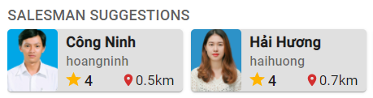
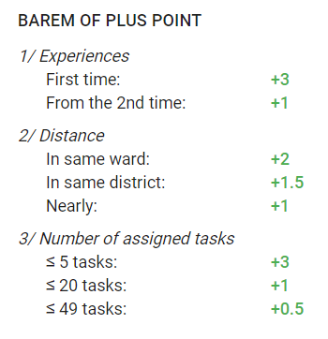

02 Our Approach
Suggestion when assign tasks
How to suggestions? – Step 2
Our criteria:
Experience*
Location* (in ward >> in district >> nearby)
Number of tasks¹
(*): Used for suggestion calculating
(1): Used for sorting Salesman (by matchPoints)

Slide 25
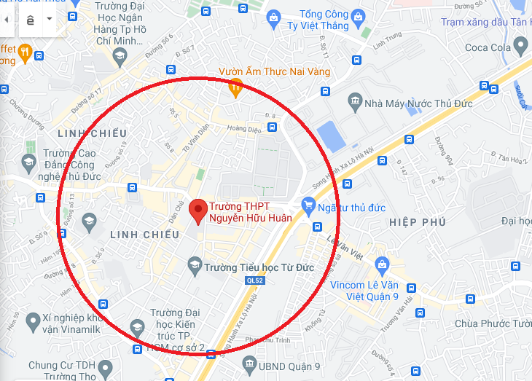
02 Our Approach
Suggestion when assign tasks
How to suggestions? – Step 3
Criteria 2: “Location”
Our Solution:
Step 1: Search Salesman in same ward
Step 2: Search Salesman in same district
Step 3: Brute force search by distance
(using Haversine formula)
listSalesmen(5) = []
(listSalesmen.length == 5) ???
(listSalesmen.length == 5) ???

Slide 26
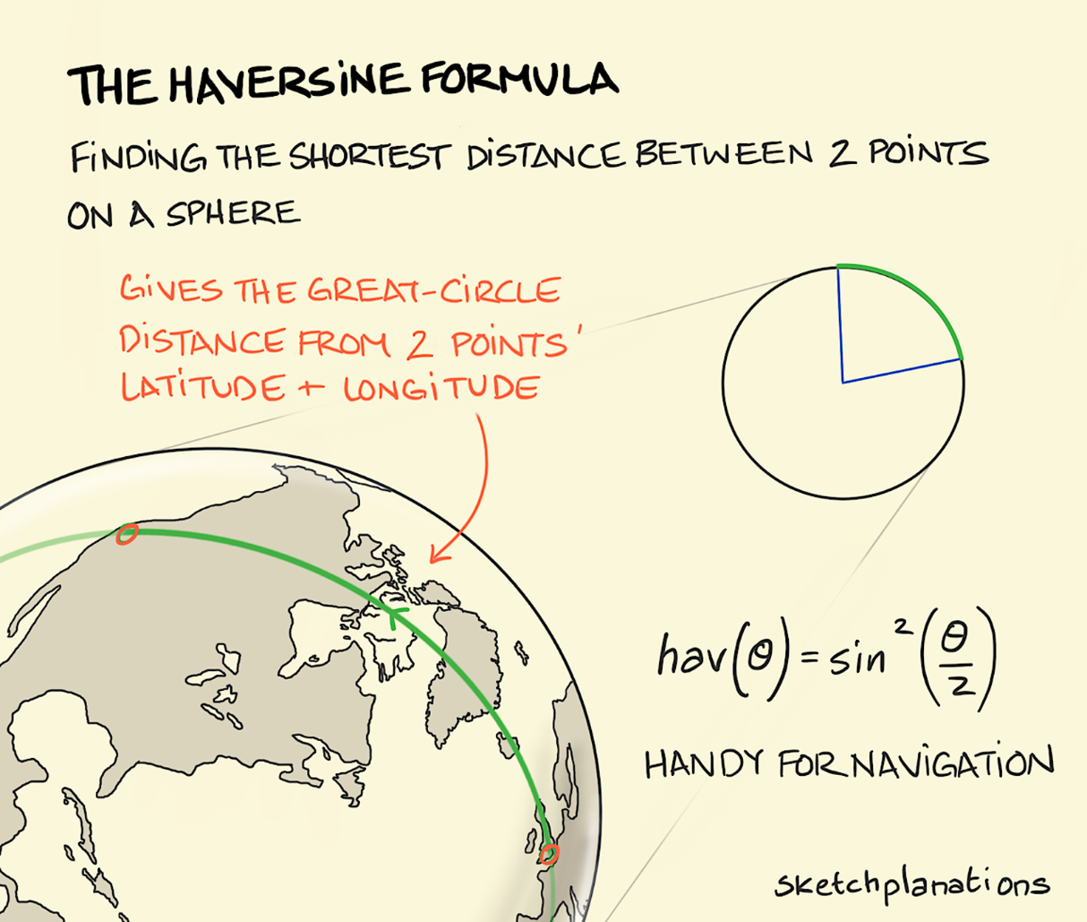
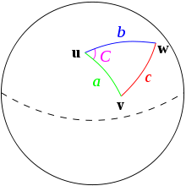
02 Our Approach
Suggestion when assign tasks
How to suggestions? – Step 3
Haversine formula
Calculate geographic distance on Earth

Slide 27
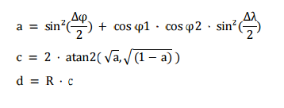
02 Our Approach
Suggestion when assign tasks
How to suggestions? – Step 3
Haversine formula

Slide 28
Demo
Assign tasks &
Suggestion when assign

Slide 29
Feature 3
Definition of KPI

Slide 30


02 Our Approach
Definition of “TASK”
KPIs
KPI
KPI
KPI
Salesman
Notes:
Để đánh giá hiệu quả cv của 1 người sẽ cần phải thông qua nhiều chỉ số KPIs. Và mỗi chỉ số này lại được tính toán từ nhiều tiêu chí.

Slide 31
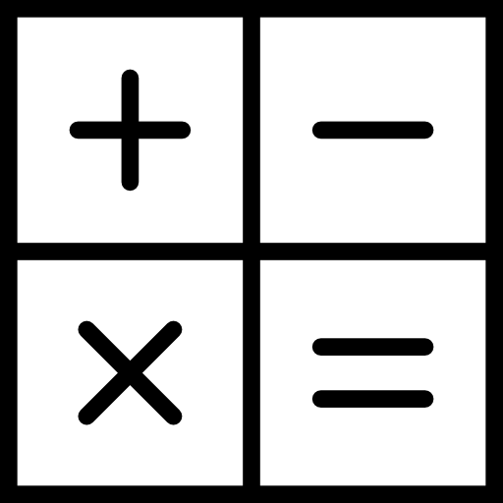


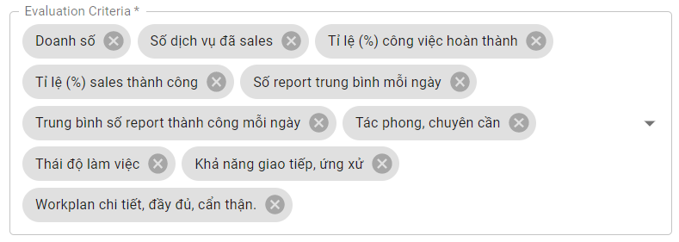
02 Our Approach
Definition of “TASK”
KPIs Criteria
Auto criteria
10 criteria
Manual criteria

Slide 32

02 Our Approach
Definition of “TASK”
How to calculate KPI?
$$KPI=\frac{actual}{target} ∗weight∗100\%$$

Slide 33
Demo
Assign tasks &
Suggestion when assign

Slide 34
03
A web application to support Sales Department of Major Education in daily working process.
A solution for digital transformation to become more automatic and efficient.
Outcome

Slide 35
04
Have not supported versions for Mobile application yet. SMSME now is a responsive Web application.
Have not supported communication channel.
Focused mainly in phase “sales” of their tasks.
Have not supported budget management.
Limitations
&
Future Plans

Slide 36
Q&A

Slide 37

Thank you

